Slide 1
House Price Prediction Project
Submitted by :
Rahul Jangra

Slide 2
INTRODUCTION

Slide 3
BUSINESS PROBLEM FRAMING
A US-based housing company named Surprise Housing has decided to enter the Australian market.
The company uses data analytics to purchase houses at a price below their actual values and flip them at a higher price. For the same purpose, the company has collected a data set from the sale of houses in Australia.
We are required to build a model using Machine Learning in order to predict the actual value of the prospective properties and decide whether to invest in them or not.

Slide 4
CONCEPTUAL BACKGROUND OF THE DOMAIN PROBLEM
In real estate the value of property usually increases with time as seen in many countries. One of the causes for this is due to rising population.
For example if audience is mainly concerned of commercial purpose. Then the property which is located in densely populated area will be sold very fast and at high prices compared to the one located at remote place.

Slide 5
The value of property also depends on the proximity of the property, its size its neighbourhood and audience for which the property is subjected to be sold.
Similarly if audience is concerned only on living place then property with less dense area having large area with all services will be sold at higher prices.

Slide 6
REVIEW OF LITERATURE
Houses are one of the necessary needs of each and every person around the globe and therefore housing and real estate market is one of the markets which is one of the major contributors in the world’s economy.
A US-based housing company named Surprise Housing has decided to enter the Australian market. The company uses data analytics to purchase houses at a price below their actual values and flip them at a higher price.

Slide 7
We are required to build a model using Machine Learning in order to predict the actual value of the prospective properties and decide whether to invest in them or not.

Slide 8
MATHEMATICAL/ ANALYTICAL MODELING OF THE PROBLEM
From this statistical analysis we make some of the interpretations that,
Maximum standard deviation of 8957.44 is observed in LotArea column.
Maximum SalePrice of a house observed is 755000 and minimum is 34900.
In the columns Id, MSSubclass, LotArea, MasVnrArea, BsmtFinSF1, BsmtFinSF2, BsmtUnfsF, TotalBsmtSF, 1stFlrSF, 2ndFlrSF, LowQualFinSF, GrLivArea, BsmtFullBath, HalfBath, TotRmsAbvGrd, WoodDeckSF, OpenPorchSF, EnclosedPorch, 3SsnPorch, ScreenPorch, PoolArea, Miscval,

Slide 9
MATHEMATICAL/ ANALYTICAL MODELING OF THE PROBLEM
salePrice mean is considerably greater than median so the columns are positively skewed.
In the columns FullBath, BedroomAbvGr, Fireplaces, Garagecars, GarageArea, YrSold Median is greater than mean so the columns are negatively skewed.
In the columns Id, MSSubClass, LotFrontage, LotArea, MasVnrArea, BsmtFinSF1, BsmtFinSF2, BsmtUnfSF, TotalBsmtSF, 1stFlrSF, 2ndFlrSF, LowQualFinSF, GrLivArea, BsmtHalfBath, BedroomAbvGr, ToRmsAbvGrd, GarageArea, WoodDeckSF, OpenPorchSF, EnclosedPorch, 3SsnPorch,

Slide 10
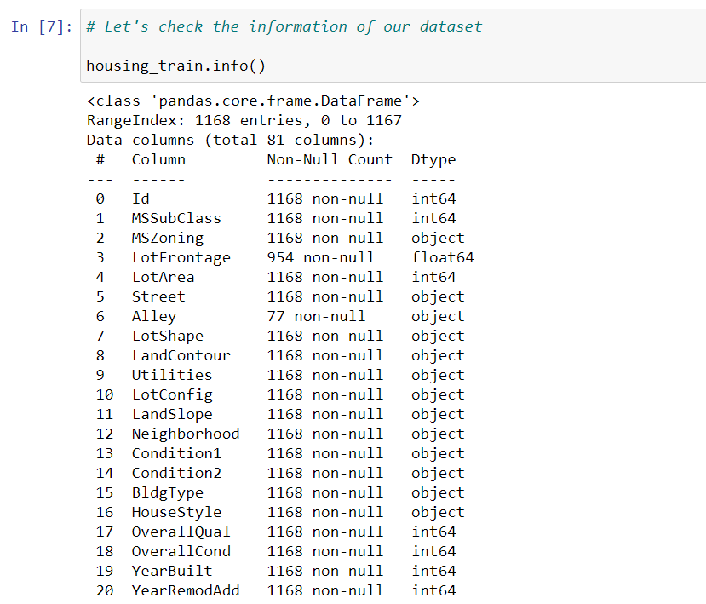
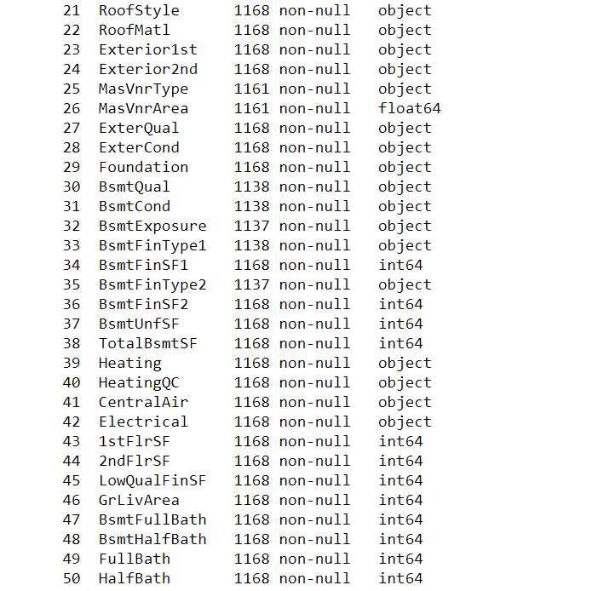
DATA SOURCES AND THEIR FORMATS

Slide 11
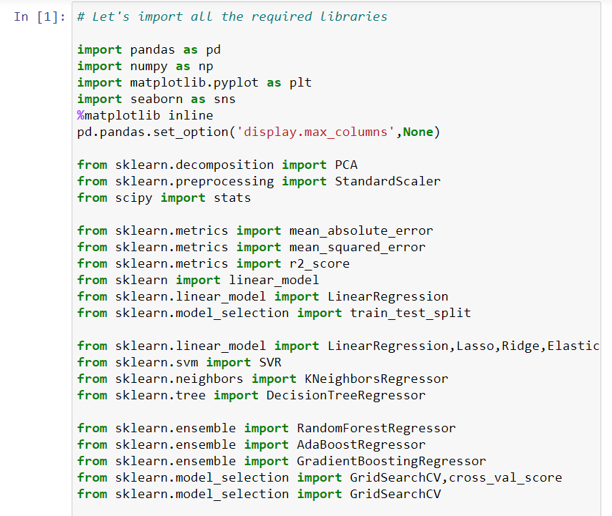
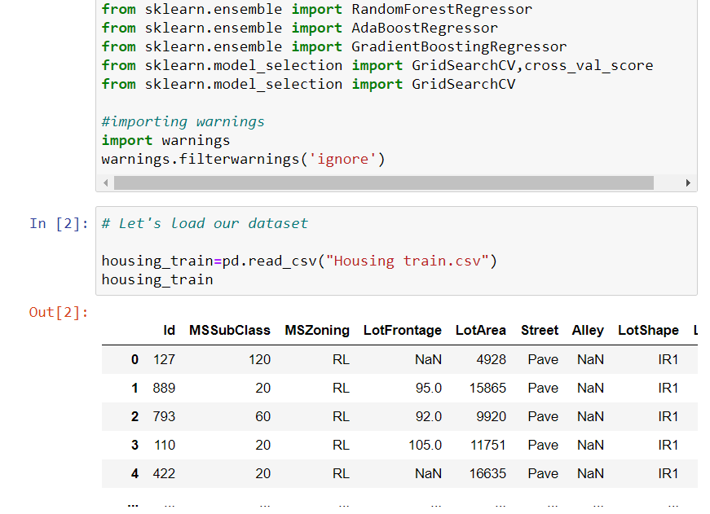
DATA PREPROCESSING DONE
After loading all the required libraries we loaded the data into our jupyter notebook.

Slide 12
Feature Engineering has been used for cleaning of the data.
Some unused columns have been deleted and even some columns have been bifurcated which was used in the prediction.
We first done data cleaning. We first looked percentage of values missing in columns then we imputed missing values.

Slide 13
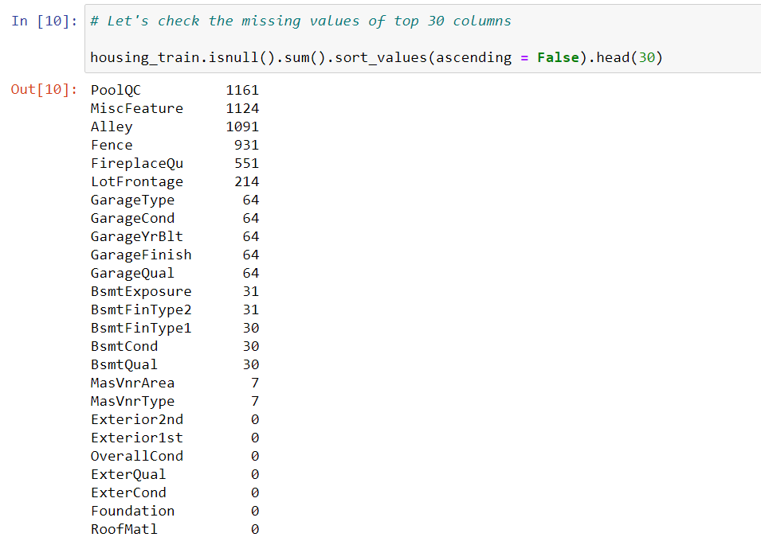
Null Values :

Slide 14
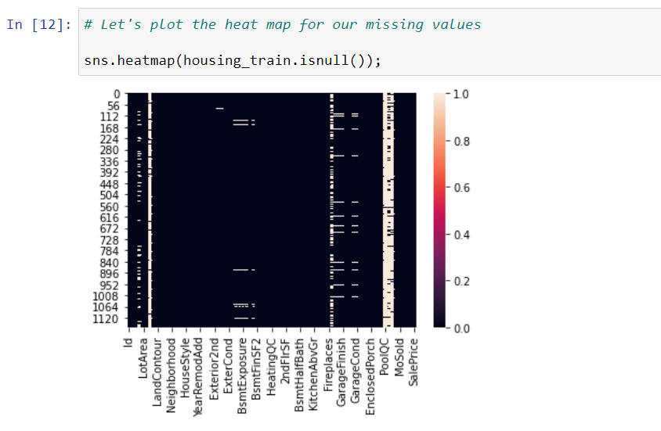
Null value Visualization

Slide 15
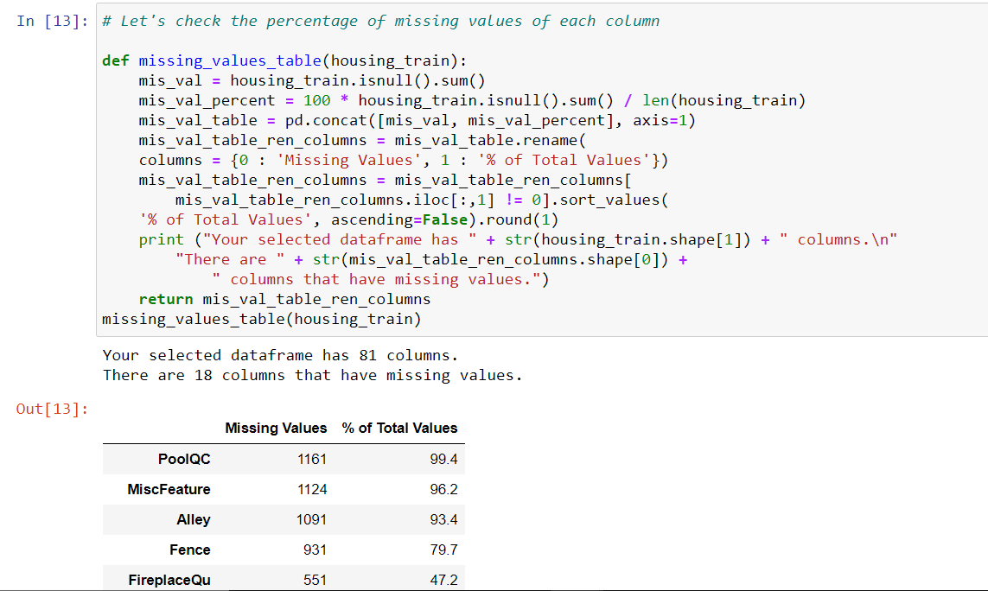
DATA PREPROCESSING

Slide 16
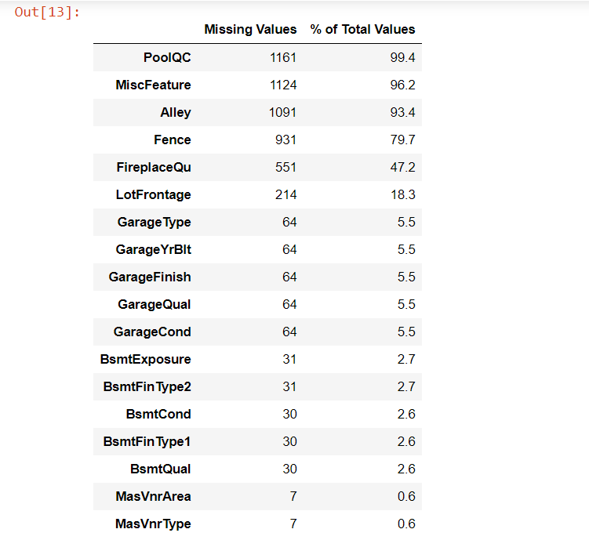
DATA PREPROCESSING

Slide 17
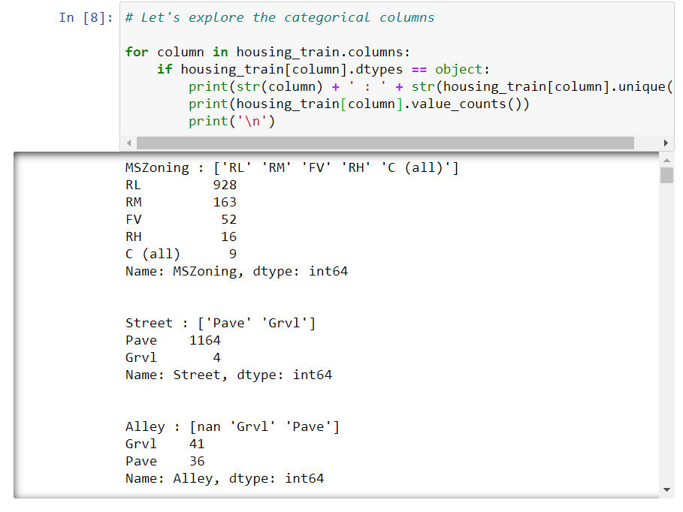
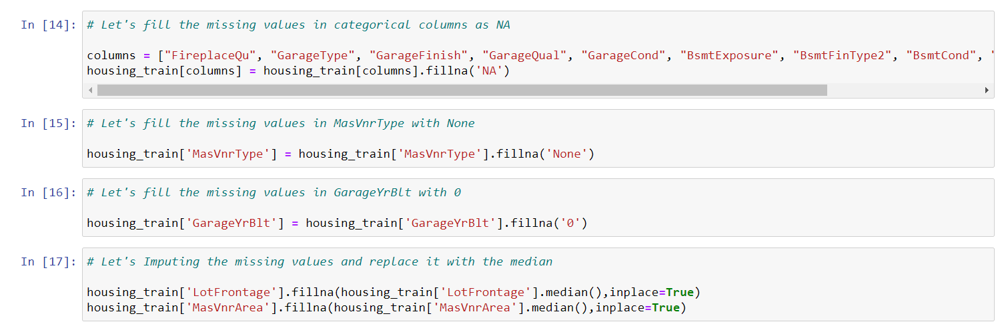

Slide 18
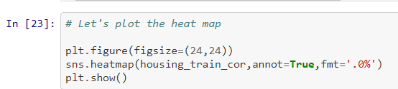
Correlation :

Slide 19
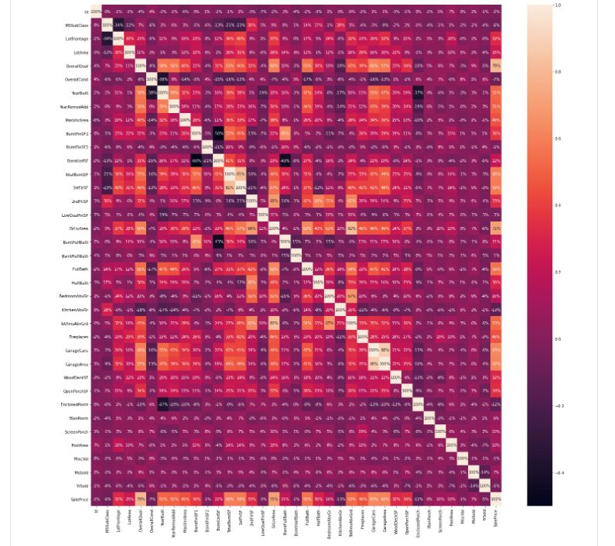

Slide 20
Correlation Observations :
While checking the heatmap of correlation we observed that:
SalePrice is highly positively correlated with the columns OverallQual, YearBuilt, YearRemodAdd, TotalBsmtSF, 1stFlrSF, GrLivArea, FullBath, TotRmsAbvGrd, GarageCars, GarageArea.
SalePrice is negatively correlated with OverallCond, KitchenAbvGr, Encloseporch, YrSold.
We observe multicollinearity in between columns so we will be using Principal Component Analysis(PCA).
No correlation has been observed between the column Id and other columns so we will be dropping this column.

Slide 21
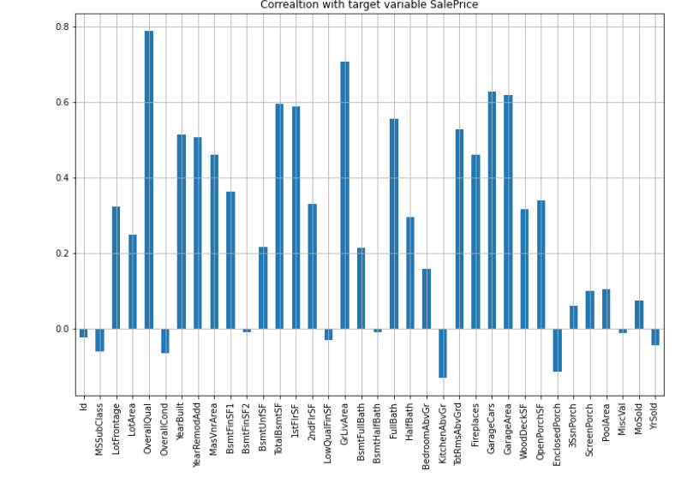
DATA INPUTS- LOGIC- OUTPUT RELATIONSHIPS

Slide 22
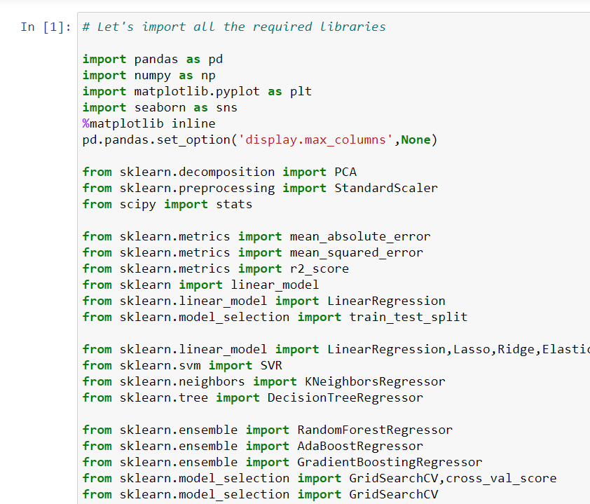
LIBRARIES-

Slide 23
MODEL/S DEVELOPMENT
AND
TESTING

Slide 24
IDENTIFICATION OF POSSIBLE PROBLEM-SOLVING APPROACHES (METHODS)
We first converted all our categorical variables to numeric variables with the help of dummy variables to checkout and dropped the columns which we felt were unnecessary.
We observed skewness in data so we tried to remove the skewness through treating outliers with Winsorization technique.
The data was improper scaled so we scaled the feature variables on a single scale using sklearn’s StandardScaler package.

Slide 25
IDENTIFICATION OF POSSIBLE PROBLEM-SOLVING APPROACHES (METHODS)
There were too many (256) feature variables in the data so we reduced it to 100 with the help of Principal Component Analysis(PCA) by plotting Eigenvalues and taking the number of nodes as our number of feature variables.

Slide 26
TESTING OF IDENTIFIED APPROACHES (ALGORITHMS)
The algorithms we used for the training and testing are as follows:-
Linear Regression
Lasso
Ridge
Elastic Net
SVR
KNeighbors Regressor
Decision Tree Regressor
Random Forest Regressor
Ada Boost Regressor
Gradient Boosting Regressor

Slide 27
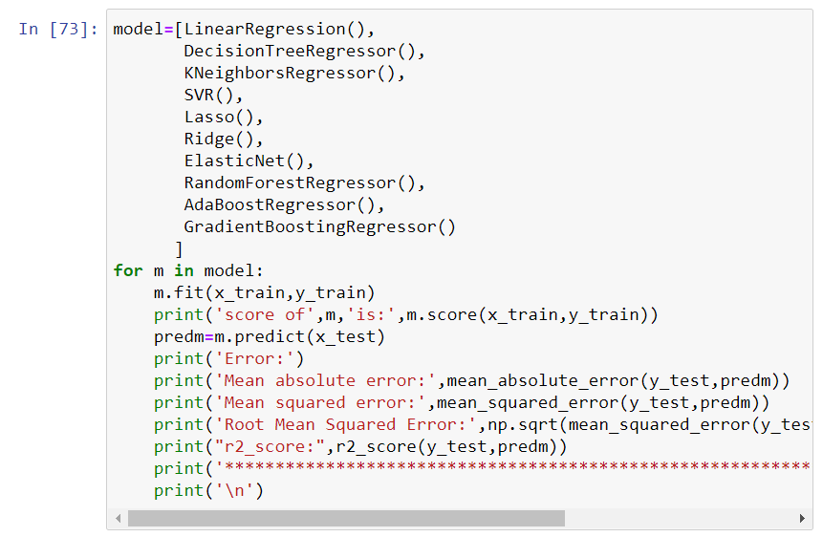
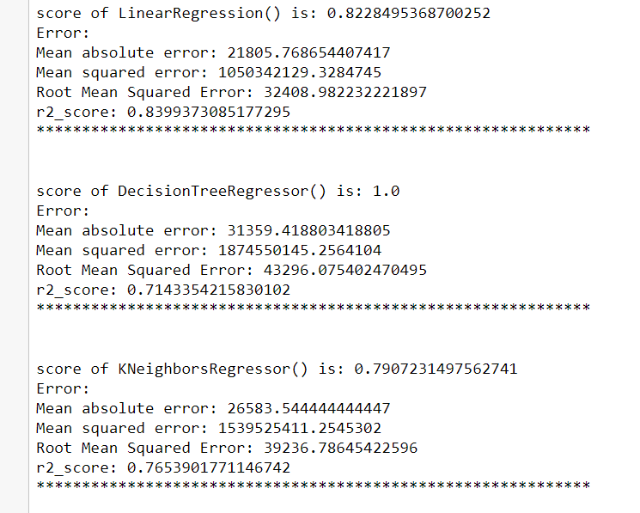
RUN AND EVALUATE SELECTED MODELS

Slide 28
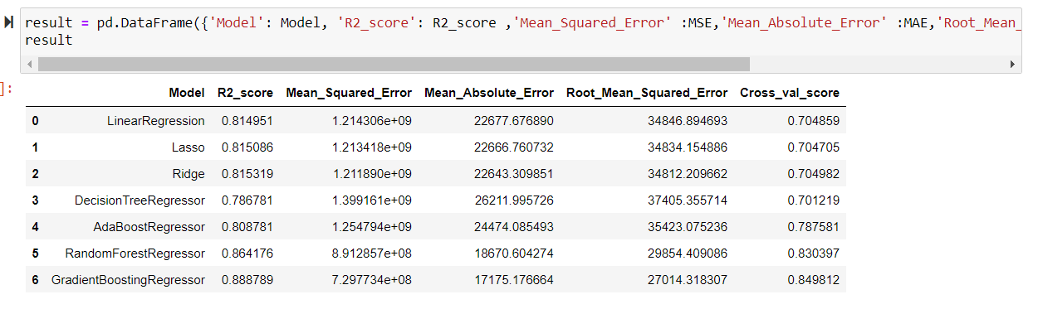
MODELS OUTPUT

Slide 29
KEY METRICS FOR SUCCESS IN SOLVING PROBLEM UNDER CONSIDERATION
We used the metric Root Mean Squared Error by selecting the Gradient boosting regressor model which was giving us best(minimum) RMSE score.

Slide 30
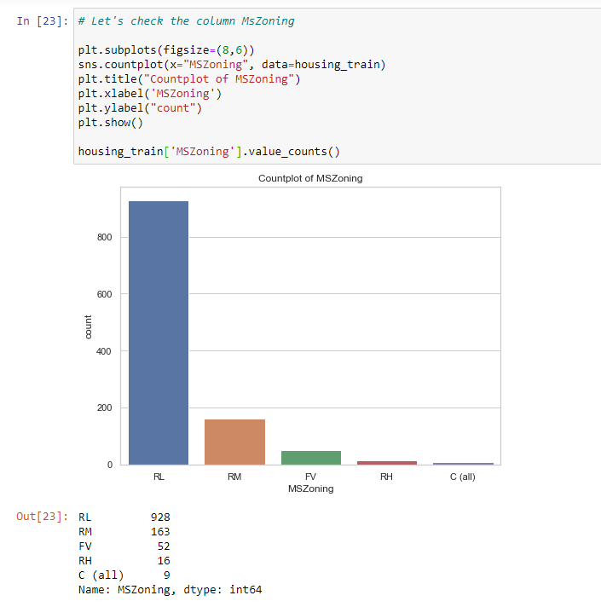

VISUALIZATIONS

Slide 31
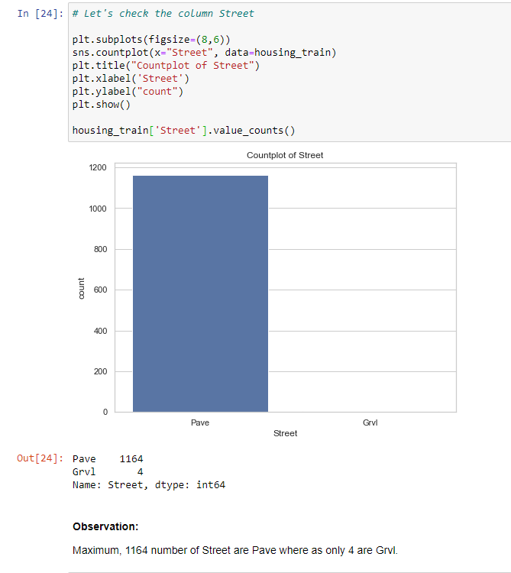
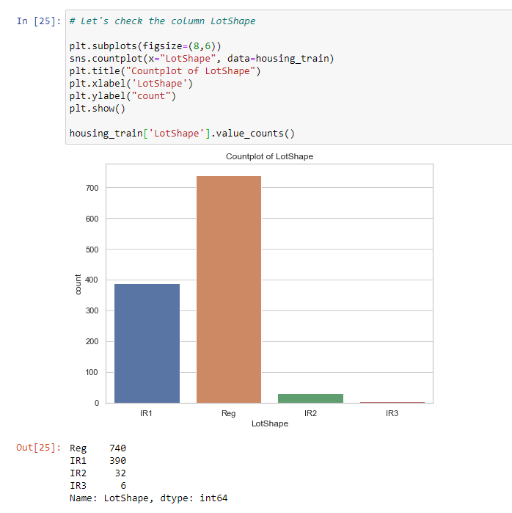

VISUALIZATIONS

Slide 32
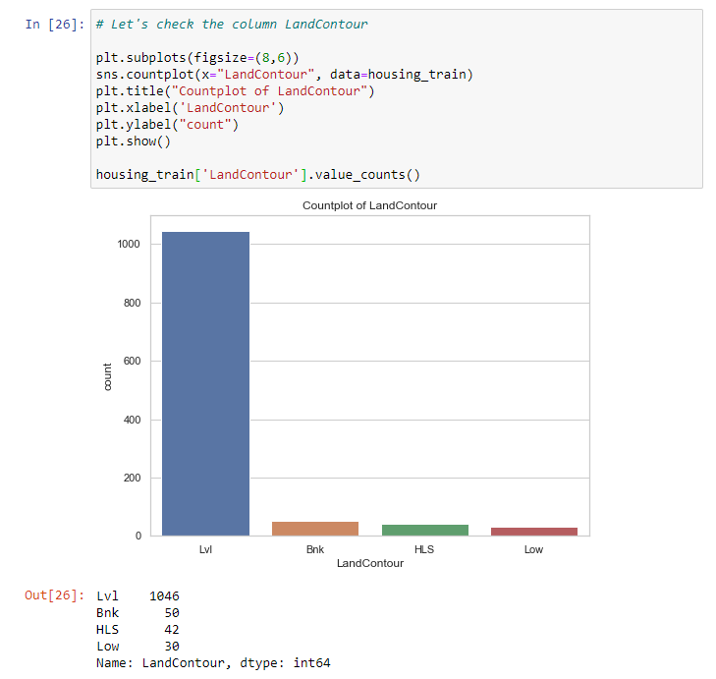

VISUALIZATIONS

Slide 33
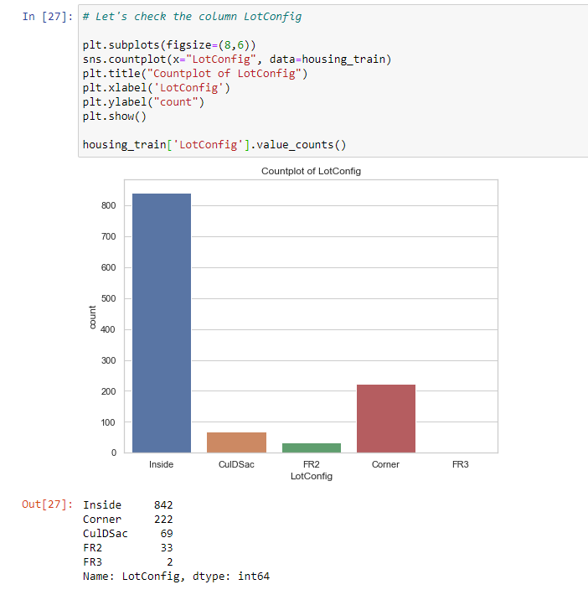

VISUALIZATIONS

Slide 34
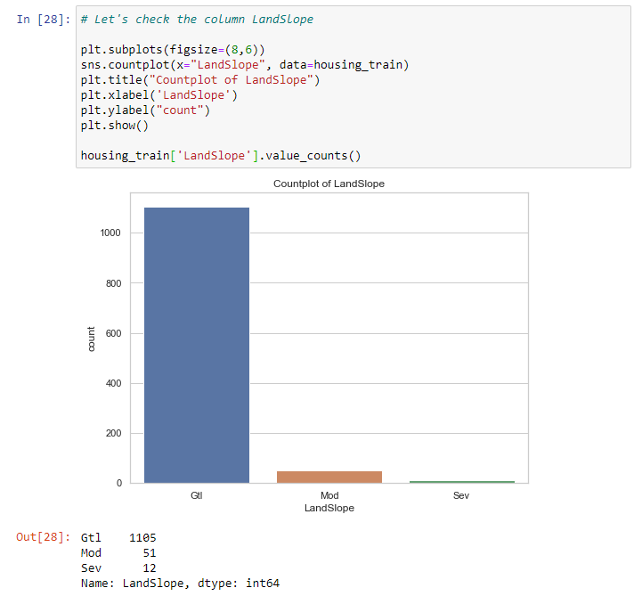

VISUALIZATIONS

Slide 35
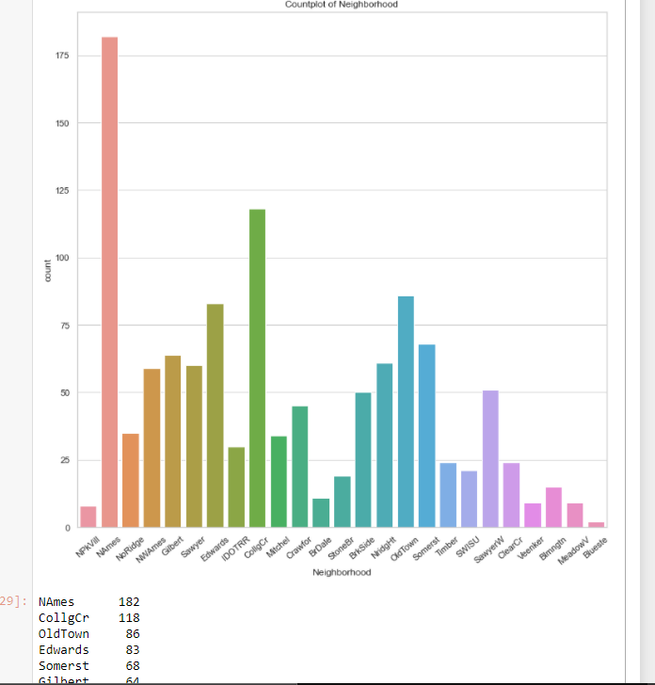
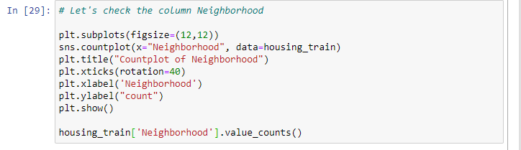

VISUALIZATIONS

Slide 36
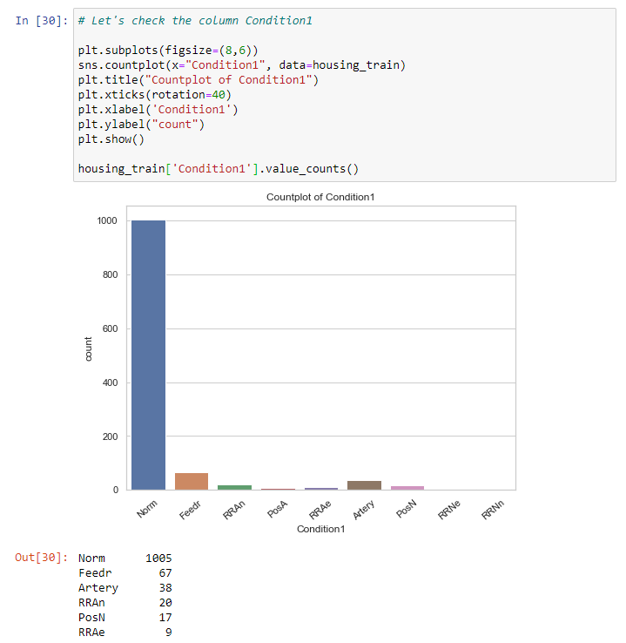

VISUALIZATIONS

Slide 37
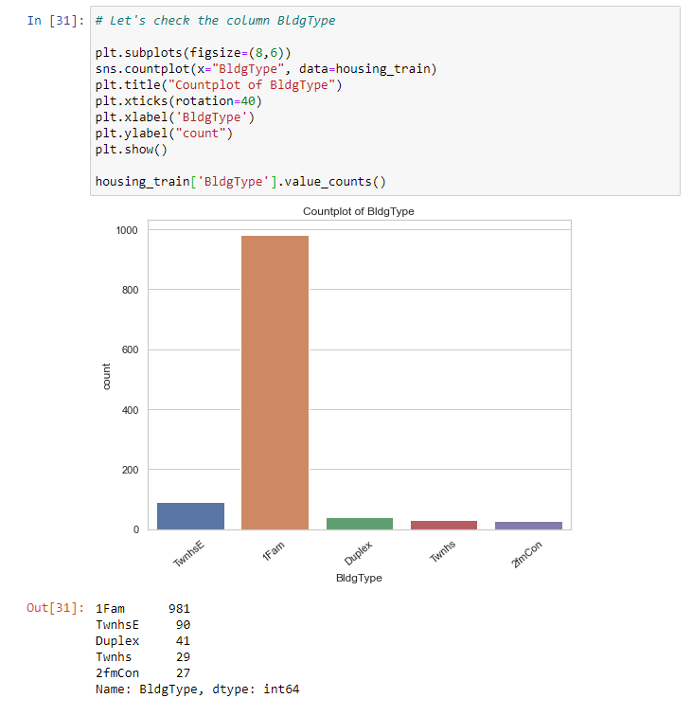

VISUALIZATIONS

Slide 38
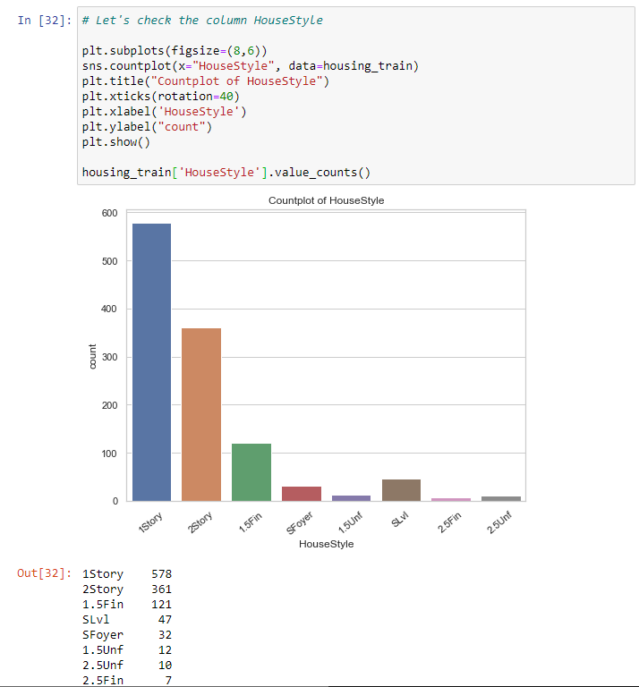

VISUALIZATIONS

Slide 39
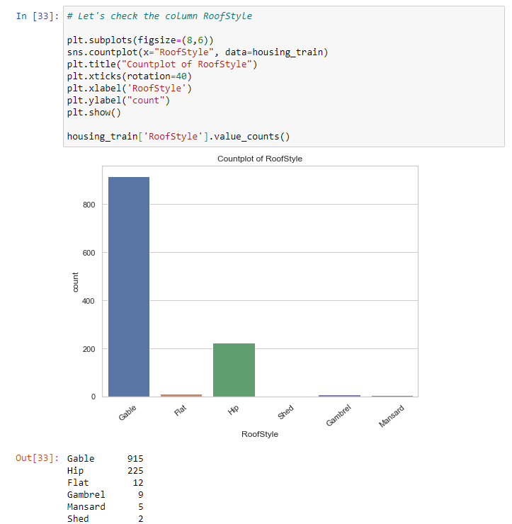

VISUALIZATIONS

Slide 40
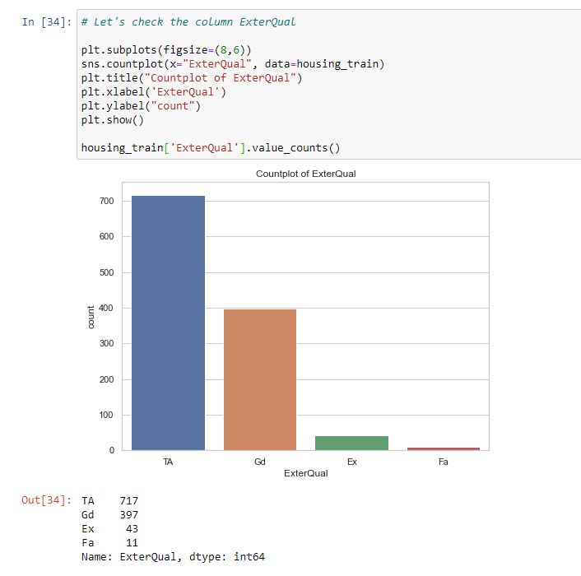

VISUALIZATIONS

Slide 41
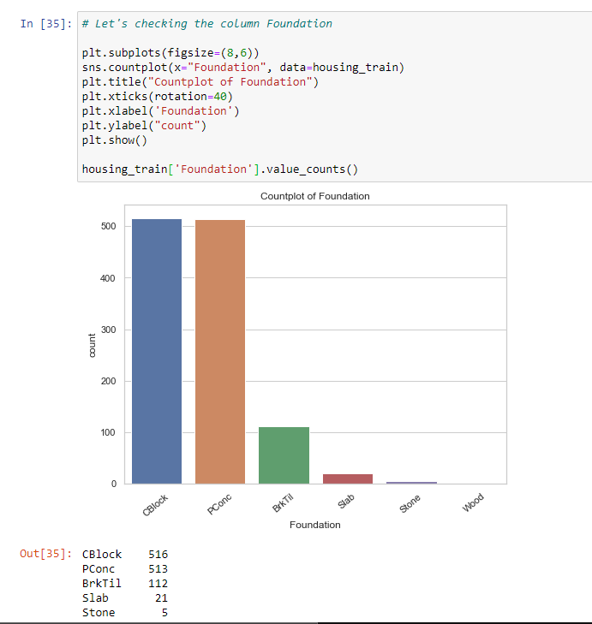

VISUALIZATIONS

Slide 42
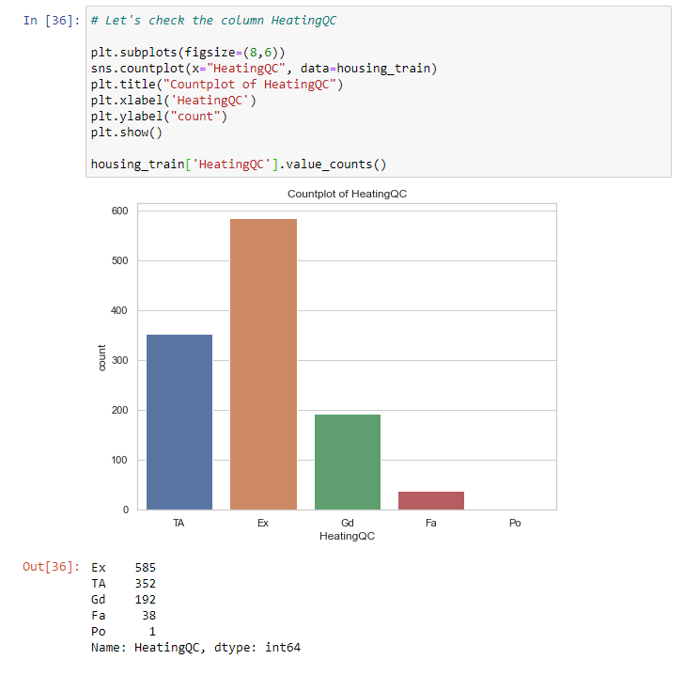

VISUALIZATIONS

Slide 43
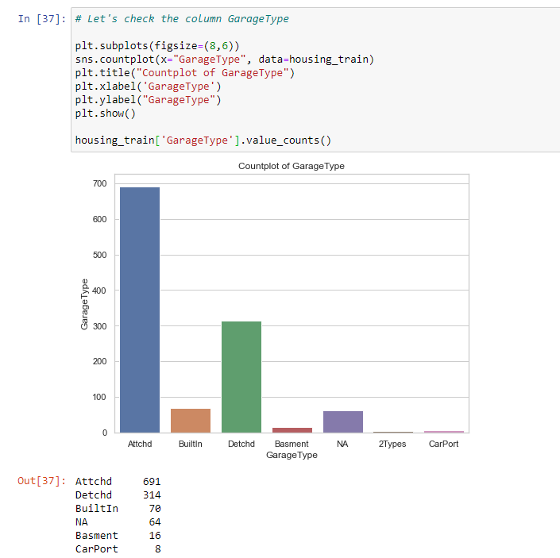

VISUALIZATIONS

Slide 44
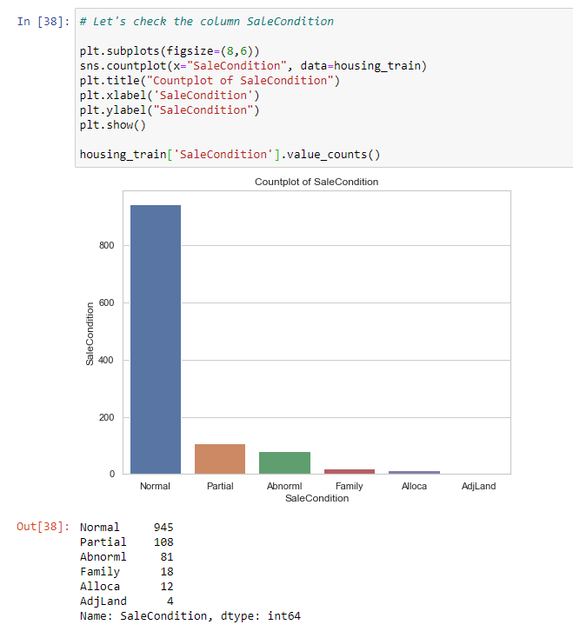

VISUALIZATIONS

Slide 45
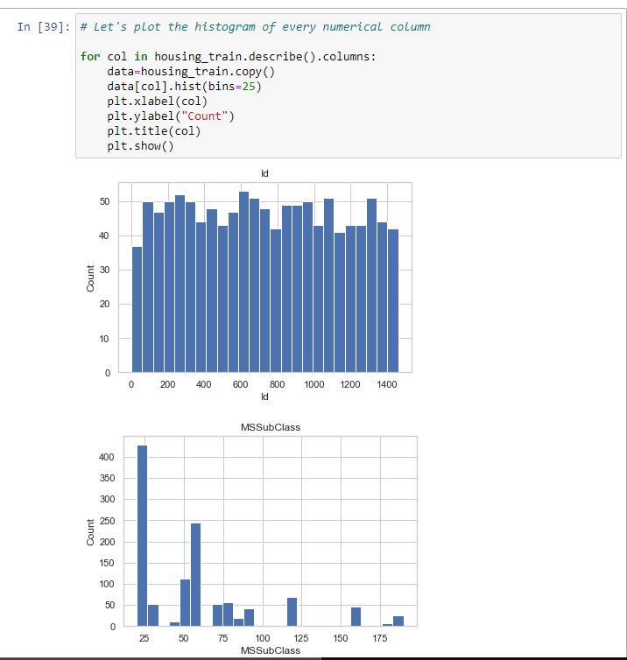
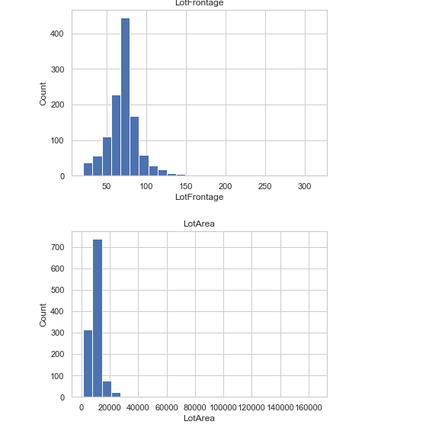
VISUALIZATIONS

Slide 46
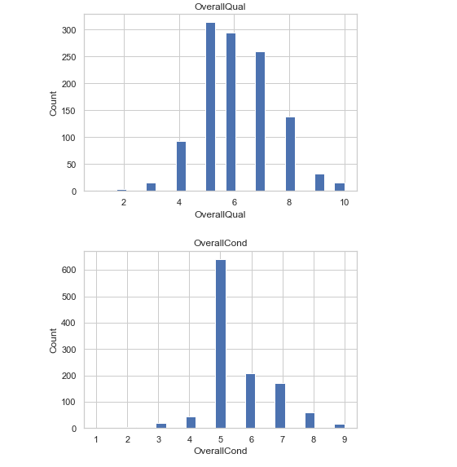
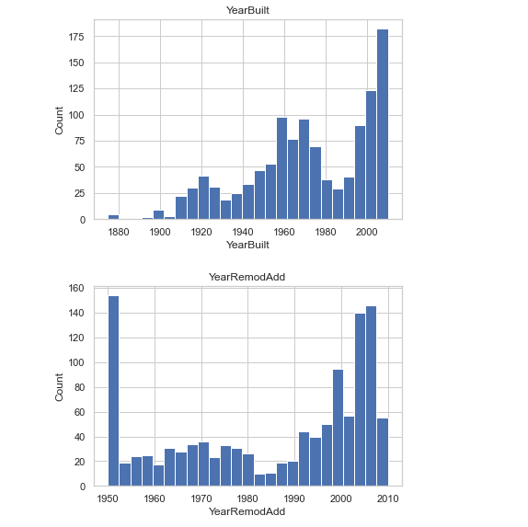
VISUALIZATIONS

Slide 47
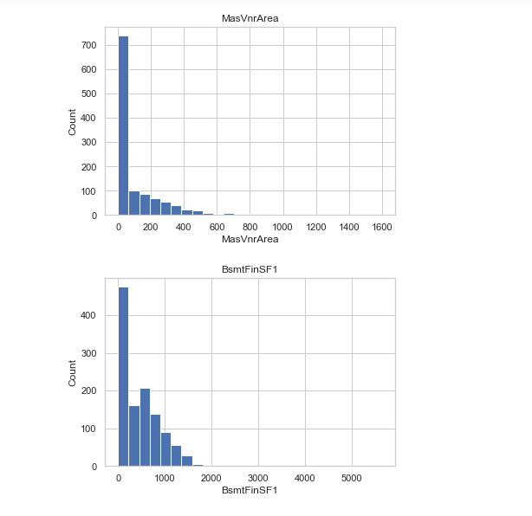
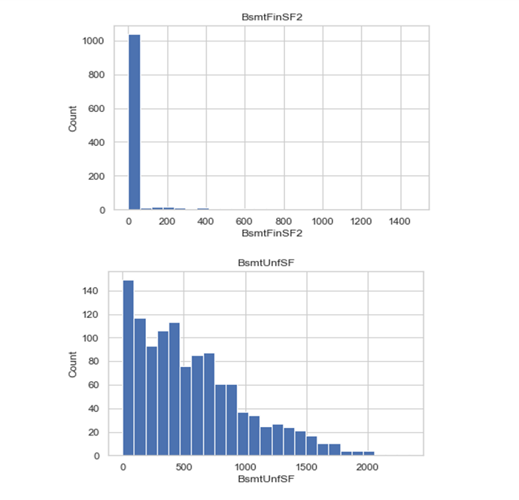
VISUALIZATIONS

Slide 48
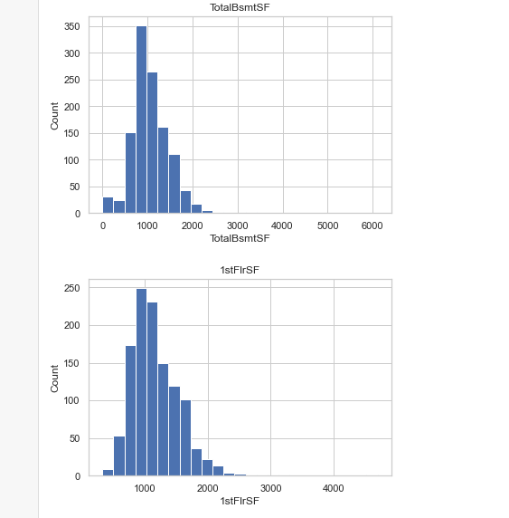
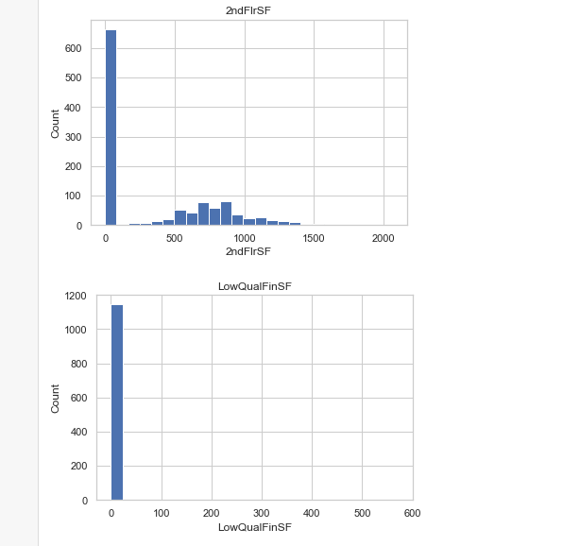
VISUALIZATIONS

Slide 49
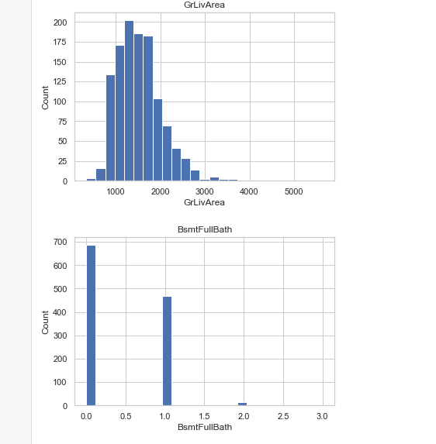
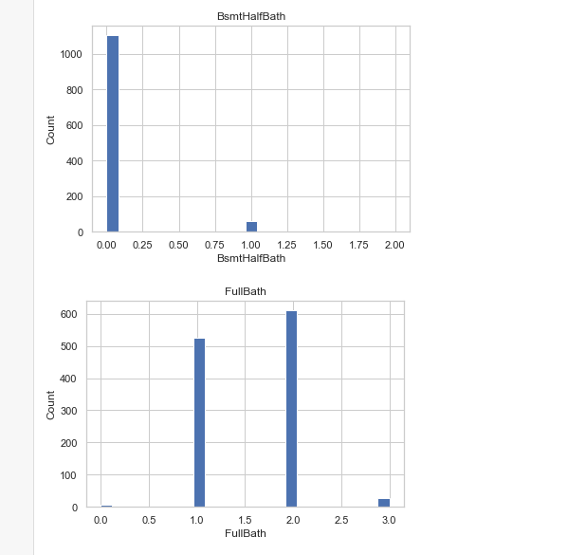
VISUALIZATIONS

Slide 50
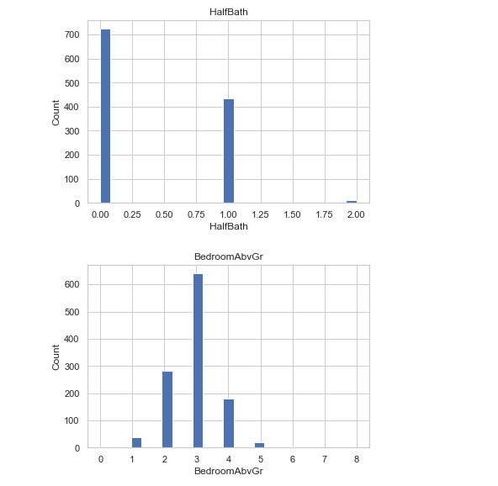
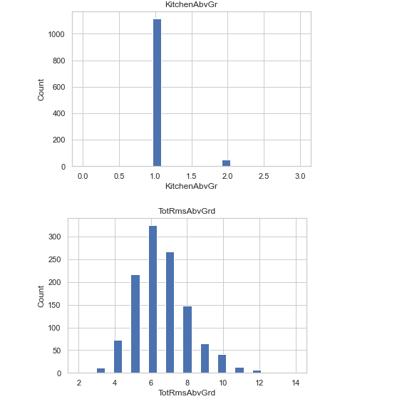
VISUALIZATIONS

Slide 51
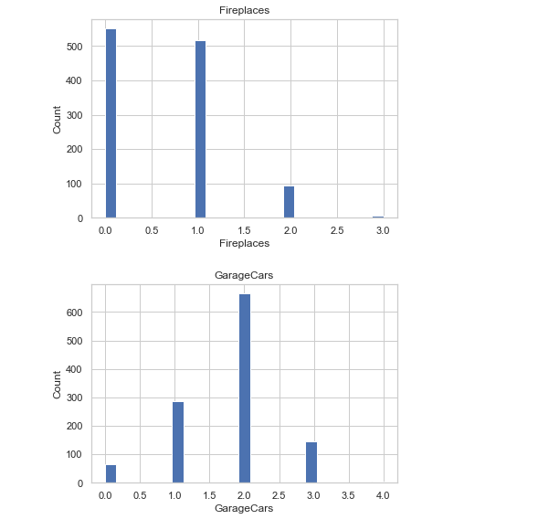
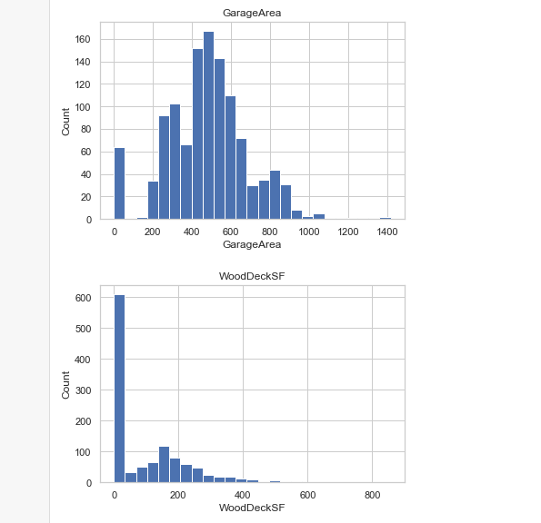
VISUALIZATIONS

Slide 52
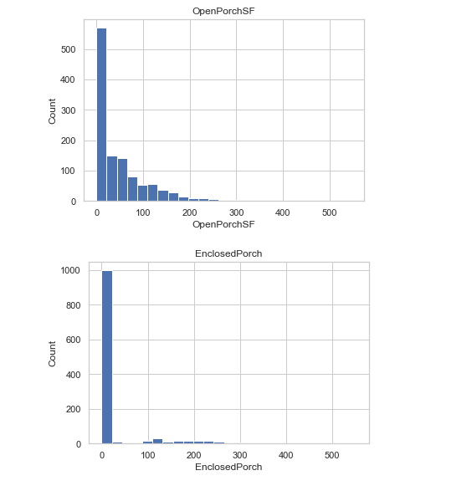
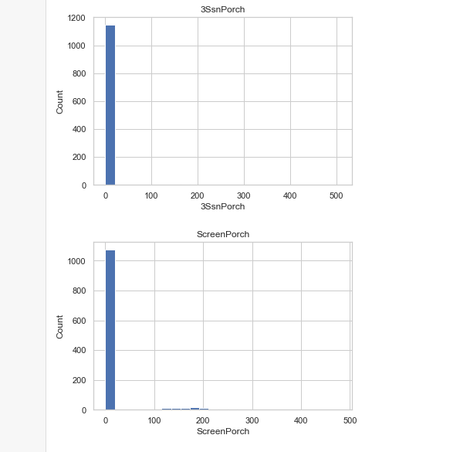
VISUALIZATIONS

Slide 53

VISUALIZATIONS

Slide 54


VISUALIZATIONS

Slide 55


VISUALIZATIONS

Slide 56


VISUALIZATIONS

Slide 57


VISUALIZATIONS

Slide 58


VISUALIZATIONS

Slide 59



VISUALIZATIONS

Slide 60


VISUALIZATIONS

Slide 61



Slide 62



Slide 63



Slide 64



Slide 65



Slide 66



Slide 67


VISUALIZATIONS

Slide 68


VISUALIZATIONS

Slide 69



Slide 70



Slide 71
SET OF ASSUMPTIONS RELATED TO THE PROBLEM UNDER CONSIDERATION
By looking into the target variable label we assumed that it was a Regression type of problem.
We observed multicollinearity in between columns so we assumed that we will be using Principal Component Analysis (PCA).
We also observed that only one single unique value was present in Utilities column so we assumed that we will be dropping this columns.

Slide 72
INTERPRETATION OF THE RESULTS
From the visualization we interpreted that the target variable SalePrice was highly positively correlated with the columns GrLivArea, YearBuilt, OverallQual, GarageCars, GarageArea.
From the preprocessing we interpreted that data was improper scaled.

Slide 73

INTERPRETATION OF THE RESULTS
From the modeling we interpreted that after hyperparameter tuning Ridge Regressor works best with respect to our model with minimum RMSE of 32302

Slide 74
CONCLUSION

Slide 75
KEY FINDINGS AND CONCLUSIONS OF THE STUDY
In this project we have tried to show how the house prices vary and what are the factors related to the changing of house prices. The best(minimum) RMSE score was achieved using the best parameters of Gradient boosting Regressor .

Slide 76
LEARNING OUTCOMES OF THE STUDY IN RESPECT OF DATA SCIENCE
This project has demonstrated the importance of sampling effectively, modelling and predicting data.
Through different powerful tools of visualization we were able to analyse and interpret different hidden insights about the data.
Through data cleaning we were able to remove unnecessary columns and outliers from our dataset due to which our model would have suffered from overfitting or underfitting.

Slide 77
LEARNING OUTCOMES OF THE STUDY IN RESPECT OF DATA SCIENCE
The few challenges while working on this project where:-
Improper scaling
Too many features
Missing values
Skewed data due to outliers
The data was improper scaled so we scaled it to a single scale using sklearns’s package StandardScaler.
There were too many(256) features present in the data so we applied Principal Component Analysis(PCA) and found out the Eigenvalues and on the basis of number of nodes we were able able to reduce our features upto 90 columns.

Slide 78
LEARNING OUTCOMES OF THE STUDY IN RESPECT OF DATA SCIENCE
There were lot of missing values present in different columns which we imputed on the basis of our understanding.
The columns were skewed due to presence of outliers which we handled through Winsorization Technique.

Slide 79
LIMITATIONS OF THIS WORK AND SCOPE FOR FUTURE WORK
While we couldn’t reach out goal of minimum RMSE in house price prediction without letting the model to overfit, we did end up creating a system that can with enough time and data get very close to that goal.
As with any project there is room for improvement here. The very nature of this project allows for multiple algorithms to be integrated together as modules and their results can be combined to increase the accuracy of the final result.
This model can further be improved with the addition of more algorithms into it.

Slide 80
LIMITATIONS OF THIS WORK AND SCOPE FOR FUTURE WORK
However, the output of these algorithms needs to be in the same format as the others. Once that condition is satisfied, the modules are easy to add as done in the code.
This provides a great degree of modularity and versatility to the project.

Slide 81
CONCLUSION
In this project we have tried to show how the house prices vary and what are the factors related to the changing of house prices.
The best(minimum) RMSE score was achieved using the best parameters of Gradient boosting .
While we couldn’t reach out goal of minimum RMSE in house price prediction without letting the model to overfit, we did end up creating a system that can with enough time and data get very close to that goal.

Slide 82
Thankyou..

